Slide 1
Outline
Network Socket
Practical
Socket in Python
Socket Class Parameters
Server socket methods
Client Socket Methods
General socket Methods
Useful socket methods

Slide 2
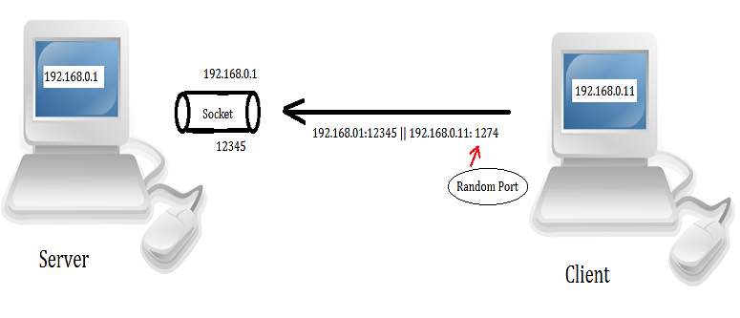
Network Socket

Slide 3
Socket in Python
A network socket address contains an IP address and port number
socket.socket()
s = socket.socket (socket_family, socket_type, protocol=0)

Slide 4
Socket Class Parameters
socket_family: socket.AF_INET, PF_PACKET
Socket_type : socket.SOCK_DGRAM,socket.SOCK_RAW,socket.SOCK_STREAM
protocol

Slide 5
Server socket methods
Open program in Debian /networking/server1.py
socket.bind(address) : connect the address (IP address, port number) to the socket
socket.listen() : starts the TCP listener
socket.accept(): accept the connection from the client

Slide 6
Client Socket Methods
socket.connect(address):
connects the client to the server. The address argument is the address of the server

Slide 7
General socket Methods
socket.send(bytes): used to send data to the socket.
socket.sendto(data, address): This method is used to send data to the socket. Generally, we use this method in UDP.

Slide 8
socket.recv(bufsize):
Receives a TCP message from the socket. The bufsize argument defines the maximum data it can receive at any one time.
socket.recvfrom(bufsize): receives data from the socket. The method returns a pair of values: the first value gives the received data, and the second value gives the address of the socket sending the data.

Slide 9
Practical
Run server1.py on Debian
Run client.py on Windows xp.
In Windows c:/clientside
Run server2.py

Slide 10
Practical
Run server1.py on Debian
Run client.py on Windows xp.
In Windows c:/clientside
Run server2.py

Slide 11
Useful socket methods
socket.gethostbyname(hostname): return a hostname to the IPv4 address format.
Example
>>> import socket
>>> socket.gethostbyname('thapar.edu')

Slide 12
Useful socket methods conti…
socket.gethostbyname_ex(name): returns a tuple (hostname, canonical name, and IP_addrlist)
socket.gethostname(): returns the hostname of the system

Slide 13
socket.gethostbyname(socket.gethostname())
socket.gethostbyname_ex(socket.gethostname())

Slide 14
Outline
Type of sniffing
Code Run
Format characters
PF_PACKET
Raw socket
Physical layer
IPv4 header
TCP Header

Slide 15
Type of sniffing
Active sniffing
Passive sniffing

Slide 16
Code Run
Run Debian Machine.
Go to directory /sniffer
Run the code sniffer1.py
Run the code str1.py
Open the code str1.py

Slide 17
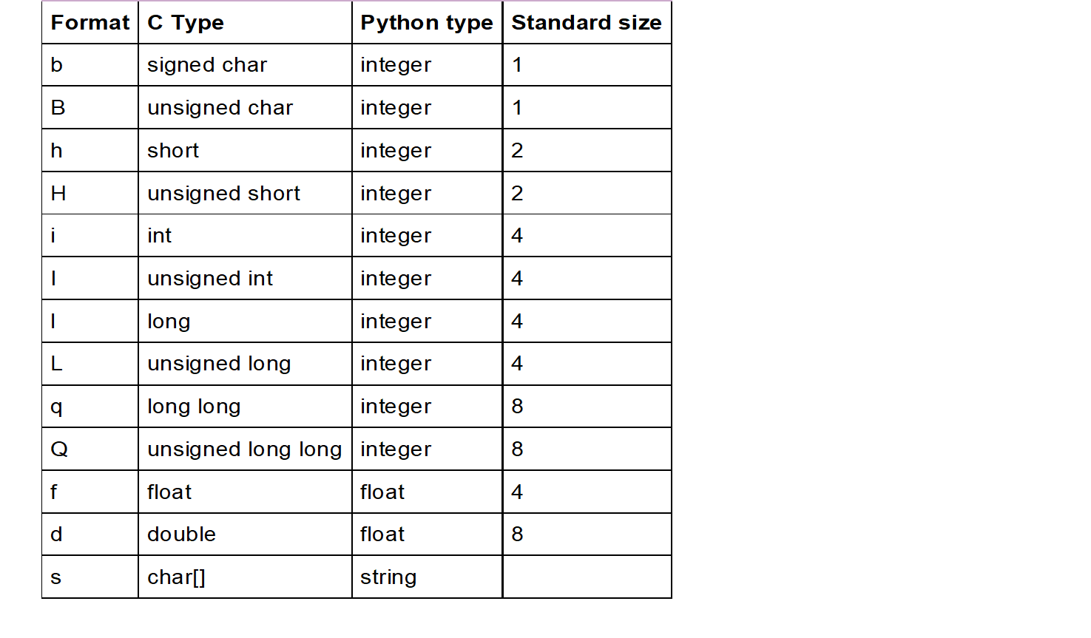
Format characters

Slide 18
Format characters examples
>>> import struct
>>> struct.pack('B',2)
'\x02'
>>> struct.pack('h',2)
'\x02\x00'

Slide 19
PF_PACKET
It operates at the device driver layer.
The pcap library for Linux uses PF_PACKET sockets.
To run this, you must be logged in as a root.

Slide 20
Raw socket
It does not care about the network layer stack and provides a shortcut to send and receive packets directly to the application.

Slide 21
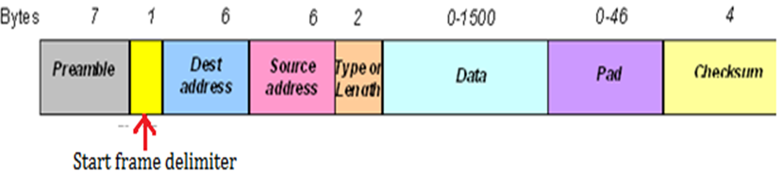
Physical layer

Slide 22
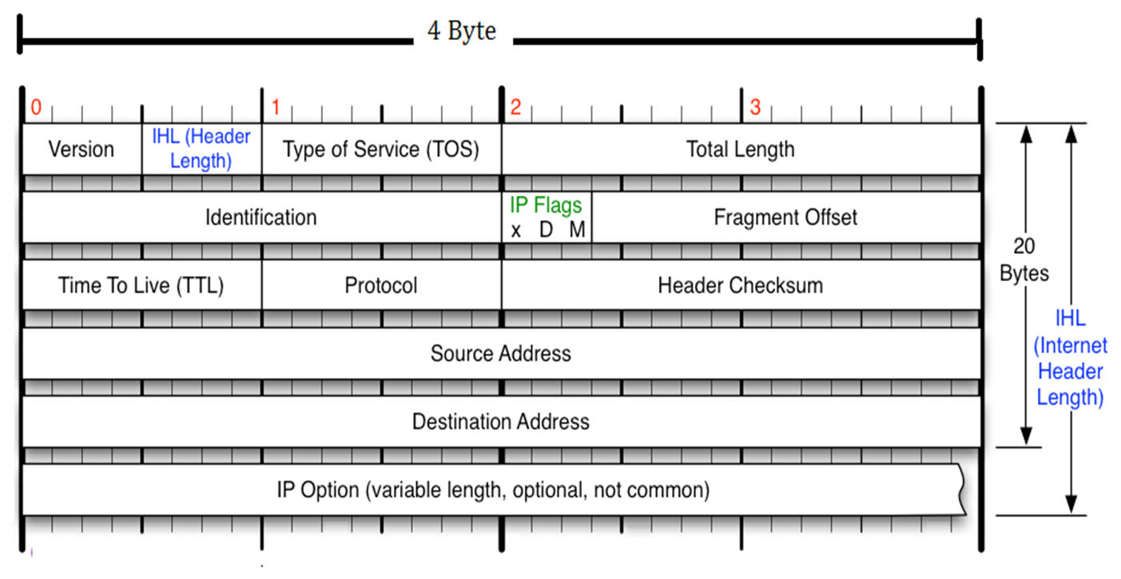
IPv4 header

Slide 23
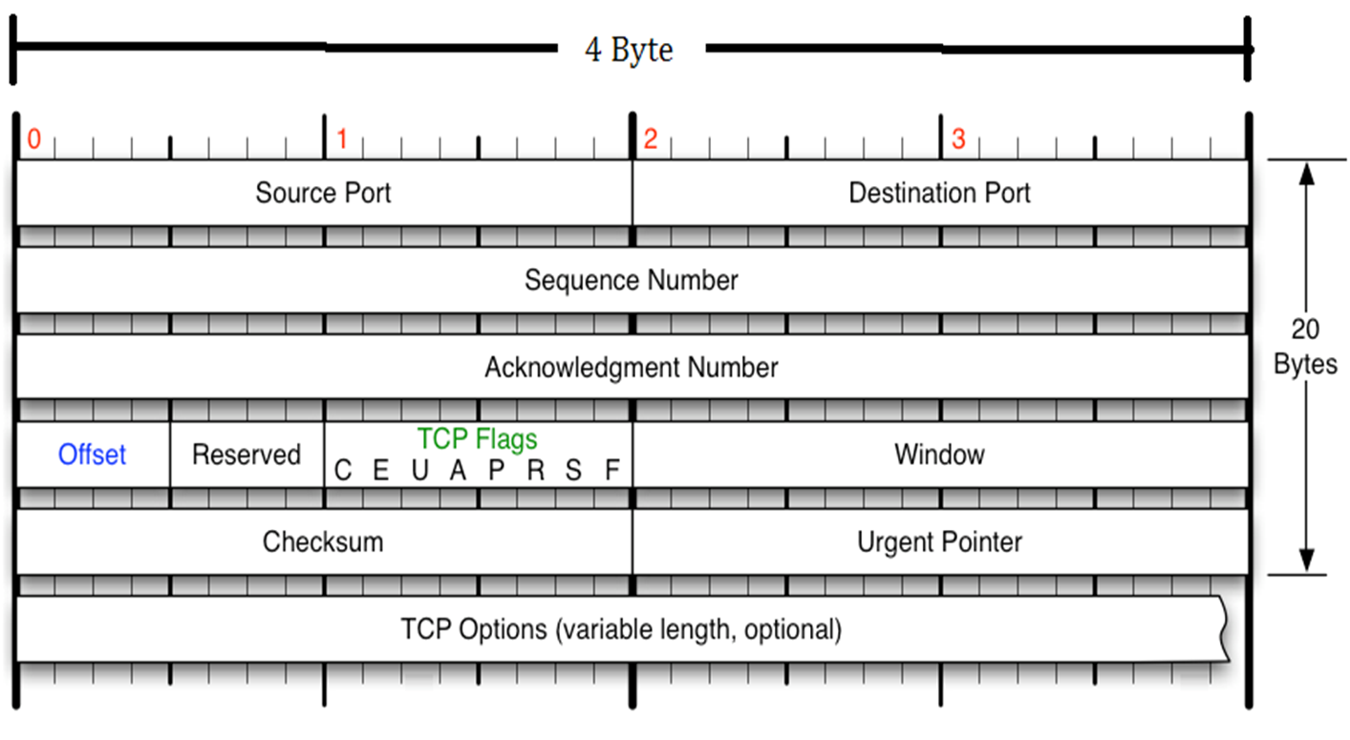
TCP Header

Slide 24
Outline
DHCP server Working
DHCP server Configuration
Test the configuration
DHCP Starvation Attack
DHCP server (Second attack)

Slide 25
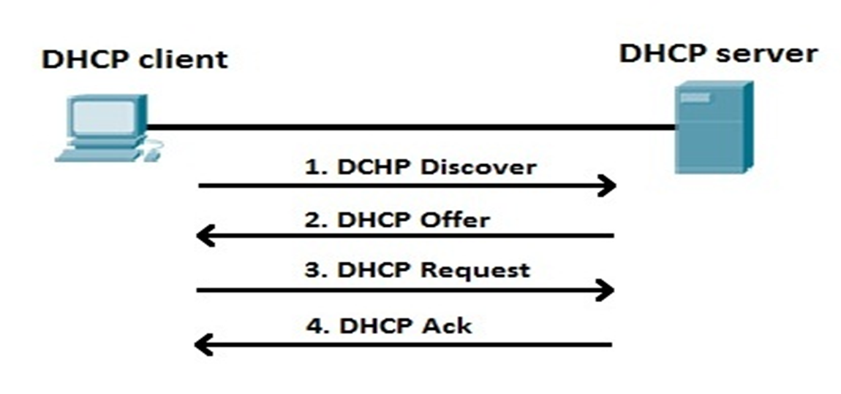
DHCP Server’s working

Slide 26
DHCP server Configuration
Start RHEL 5
Check the configuration of file /etc/dhcpd.conf
Open file /var/lib/dhcpd/dhcpd.leases in new terminal, ( use command tail -f)
Check the status of DHCP server, use command service dhcpd status

Slide 27
Test the configuration
Turn off the VMware DHCP server
Boot the Windows XP
Check the Ipconfig of Windows XP.

Slide 28


Slide 29
Prerequisites
Turn off DHCP server of Vmware
Turn on the RHEL.
Start the DHCP server
service dhcpd start

Slide 30
Attack
In Debian, Run the code
Cd /
Cd dhcp_strav
Python dhcp_starvation1.py

Slide 31
Restore
Stop the dhcp_starvation1.py
rm /var/lib/dhcpd/dhcpd.leases
Restart the DHCP server
service dhcpd restart

Slide 32
Second attack
Run the code arp_reply.py
Python arp_reply <your MAC>
Run the code icmp_reply.py
For testing
Start the Windows XP

